Slide 1
Support Vector Machine
https://ankitnitjsr13.medium.com/math-behind-support-vector-machine-svm-5e7376d0ee4d
https://www.simplilearn.com/tutorials/data-science-tutorial/svm-in-r
https://www.freecodecamp.org/news/svm-machine-learning-tutorial-what-is-the-support-vector-machine-algorithm-explained-with-code-examples/

Slide 2
Support Vector Machine
SVM is one of the most popular, versatile supervised machine learning algorithm.
It is used for both classification and regression task. But in this thread we will talk about classification task.
It is usually preferred for medium and small sized data-set.

Slide 3
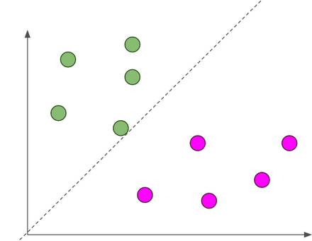
SVM
The main objective of SVM is to find the optimal hyperplane which linearly separates the data points in two component by maximizing the margin .
dotted line is hyperplane, separating blue and pink classes balls

Slide 4
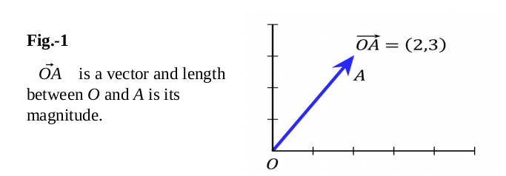
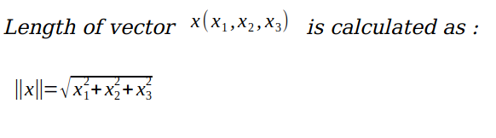
Basic Linear Algebra
Vectors- Vectors are mathematical quantity which has both magnitude and direction.
A point in the 2D plane can be represented as a vector between origin and the point.
Length of Vectors- Length of vectors are also called as norms. It tells how far vectors are from the origin.

Slide 5
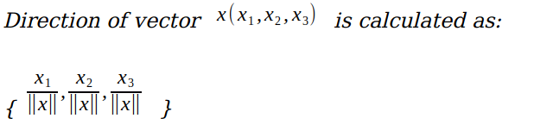
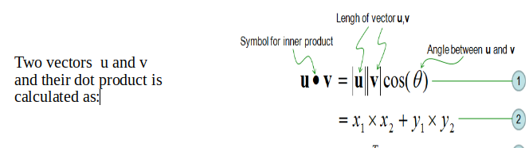
SVM
Direction of vectors
Dot Product
Dot product between two vectors is a scalar quantity . It tells how to vectors are related.

Slide 6
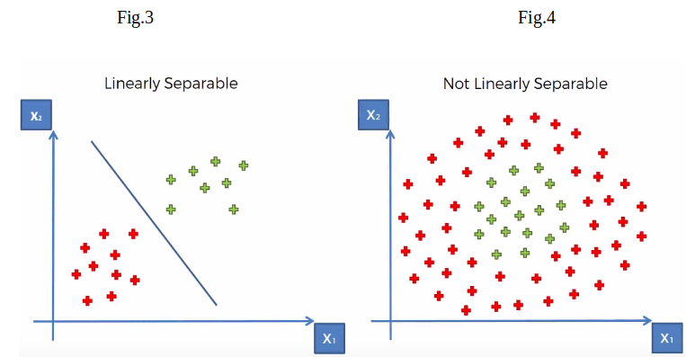
Hyper-plane
It is plane that linearly divide the n-dimensional data points in two component. In case of 2D, hyperplane is line, in case of 3D it is plane.It is also called as n-dimensional line. Fig.3 shows, a blue line(hyperplane) linearly separates the data point in two components. In the Fig.3, hyperplane is line divides data point into two classes(red & green), written as

Slide 7
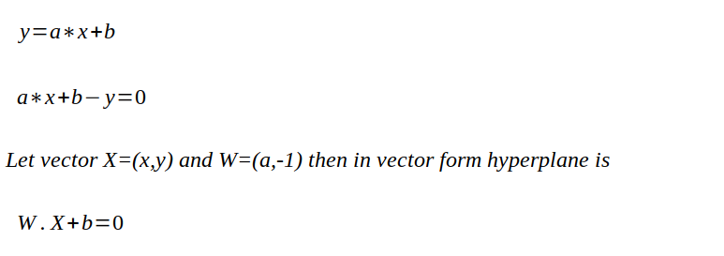
Linearly Separable
In the Fig.3, hyperplane is line divides data point into two classes(red & green), written as

Slide 8
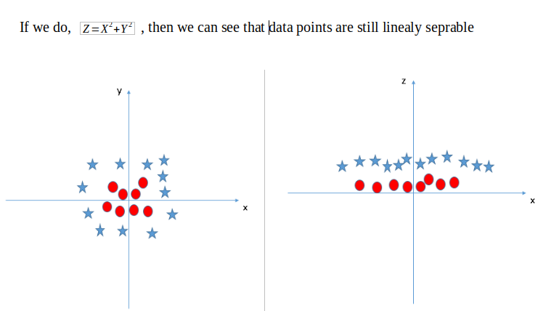
What if data points is not linearly separable ?
Look Fig.4 how can we separate the data-points linearly?
This type of situation comes very often in machine learning world as raw data are always non-linear here.
So, Is it do-able? yes!!. we will add one extra dimension to the data points to make it separable.
process of making non-linearly separable data point to linearly separable data point is also known as Kernel Trick.

Slide 9
Types of Support Vector Machines
There are two types of Support Vector Machines:
Linear SVM or Simple SVM: Linear SVM is used for linearly separable data. If a dataset can be classified into two classes with a single straight line, then that data is considered to be linearly separable data, and the classifier is referred to as the linear SVM classifier. It is typically used for linear regression and classification problems.
Nonlinear SVM or Kernel SVM: Nonlinear SVM is used for nonlinearly separated data, i.e., a dataset that cannot be classified by using a straight line. The classifier used in this case is referred to as a nonlinear SVM classifier. It has more flexibility for nonlinear data because more features can be added to fit a hyperplane instead of a two-dimensional space.

Slide 10
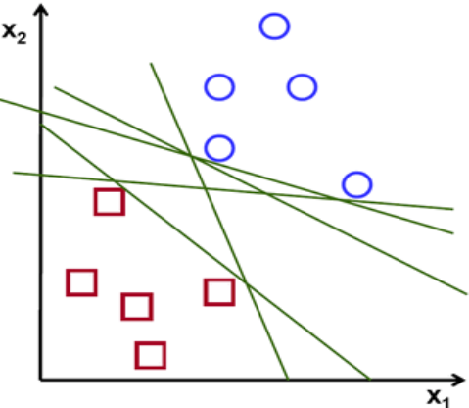
Optimal Hyper plane
Fig6. there are numbers of hyperplane that can separate the data points in two components.
So optimal hyperplane is one which divides the data points very well.
So question is why it is needed to choose optimal hyper plane?
So if you choose sub-optimal hyperplane, no doubt after number of training iteration , training error will decrease but during testing when an unseen instance will come, it will result in high test error.
In that case it is must to choose an optimal plane to get good accuracy.

Slide 11
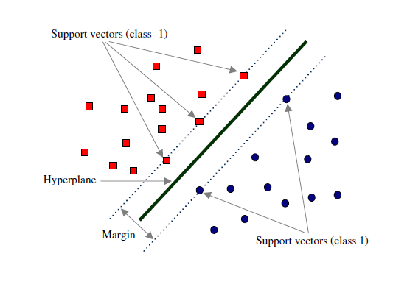
How to choose Optimal Hyperplane ?
Margin and Support Vectors
Let’s assume that solid black line figure is optimal hyperplane and two dotted line is some hyperplane, which is passing through nearest data points to the optimal hyperplane.
Then distance between hyperplane and optimal hyperplane is know as margin, and the closest data-points are known as support vectors.
Margin is an area which do not contains any data points.
There will be some cases when we have data points in margin area but right now we stick to margin as no data points lands.
Fig.7

Slide 12
How to choose Optimal Hyperplane ?
So, when we are choosing optimal hyperplane we will choose one among set of hyperplane which is highest distance from the closest data points.
If optimal hyperplane is very close to data points then margin will be very small and it will generalize well for training data but when an unseen data will come it will fail to generalize well as explained above.
So our goal is to maximize the margin so that our classifier is able to generalize well for unseen instances.
So, In SVM our goal is to choose an optimal hyperplane which maximizes the margin.
Fig.7

Slide 13
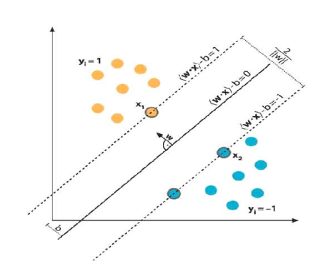
Mathematical Interpretation of Optimal Hyperplane
we have L training examples where each example x are of D dimension and each have labels of
either y=+1 or y= -1 class, and examples are linearly separable.
Then, our training data is form ,

Slide 14
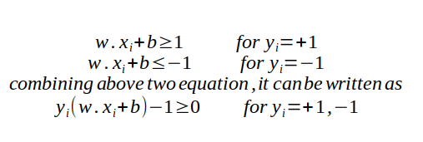
Linear separable data points.
We consider D=2 to keep explanation simple and data points are linearly separable, The hyperplane w.x+b=0 can be described as shown in figure :
Support vectors examples are closest to optimal hyperplane and the aim of the SVM is to orientate this hyperplane as far as possible from the closest member of the both classes.
From the above Fig , SVM problem can be formulated as,

Slide 15
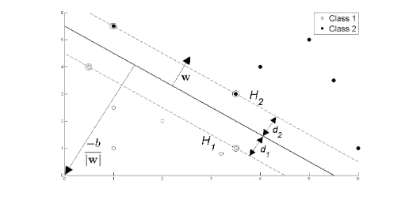
From the Fig.8 we have two hyperplane H1 and H2 passing through the support vectors of +1 and -1 class respectively. so
w.x+b=-1 :H1
w.x+b=1 :H2
And distance between H1 hyperplane and origin is (-1-b)/|w| and distance between H2 hyperplane and origin is (1–b)/|w|. So, margin can be given as
M=(1-b)/|w|-(-1-b)/|w|
M=2/|w|
Where M is nothing but twice of the margin. So margin can be written as 1/|w|.

Slide 16
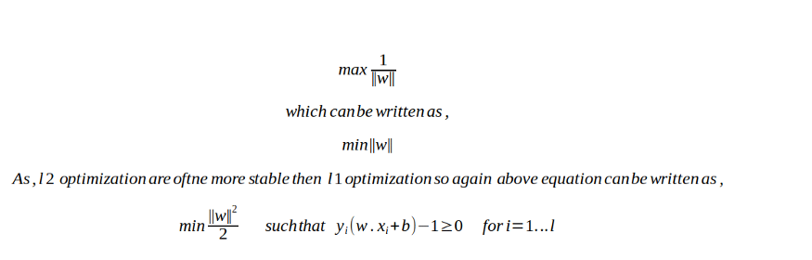
Optimal Hyperplane
As, optimal hyperplane maximize the margin, then the SVM objective is boiled down to fact of maximizing the term 1/|w|,

Slide 17
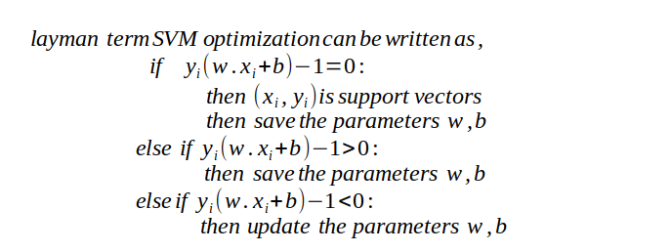
SVM optimization
To make you comfortable, Learning algorithms of SVM are explained with pseudo code explain below.
This is very abstract concept in SVM optimization.
For below code assume x is data point and y is its corresponding labels.

Slide 18
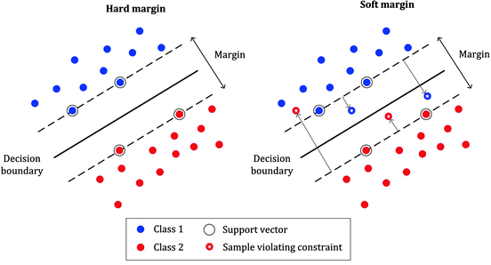
Soft and Hard margin classification
No data points are allowed in the margin areas. This type of linear classification is known as Hard margin classification.

Slide 19
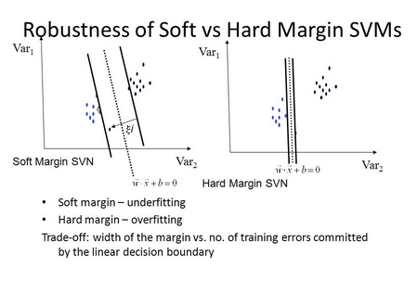
Soft and Hard margin classification

Slide 20
so what should we do??
To avoid these issues it is preferable to use more flexible model.
As most of real world data are not fully linearly separable, we will allow some margin violation to occur.
It is better to have large margin, even though some constraints is violated.
Margin violation means choosing an hyperplane, which can allow some data points to stay in either in between the margin area or in the incorrect side of hyperplane,which is contrast to hard margin classification task . This type of classification are called as soft margin classification.

Slide 21
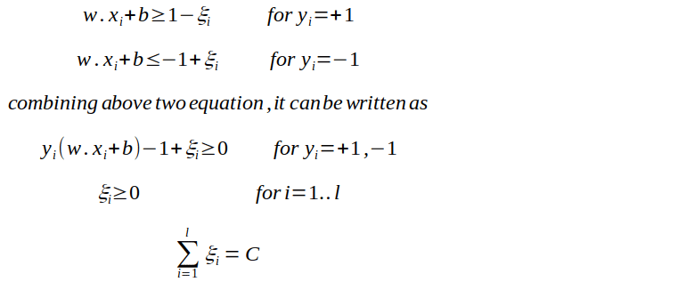
what does it mean Mathematically??
we will relax the constrains of the equation slightly to allow the margin violation to occur with the help of positive slack variable ξi. so now above equation can be written as,

Slide 22
slack variable ξi
ξi actually tells where the ith observation is located relative to hyperplane and margin,for 0<ξi≤1, then observation is between incorrect side of margin and correct side of hyperplane.This is margin violation.
for ξi>1 ,observation is on the incorrect side of both hyperplane and margin, and point is misclassified.
And in the soft margin classification task, the observation is on the incorrect side of margin have penalty which increases as distance from it increases.
C is the parameter which controls the trade-off between length of margin and number of the misclassification on the training data.
For C=0, It is not letting any misclassification to occur which is a nothing but hard margin classification and it result in narrow margin,
For C>0, it mean no more than C observation can violate the margin, as C increases margin also widens.
The correct value of C is decided by cross-validation and it is this parameter only, that can result in bias-variance trade-off in SVM. If the value of C =0, which results in high variance but if the value of C= ∞ it results in high bias.

Slide 23
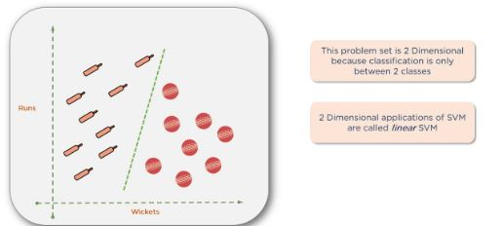
Linear SVM-Example
This problem set is two-dimensional because the classification is only between two classes. It is called a linear SVM.

Slide 24
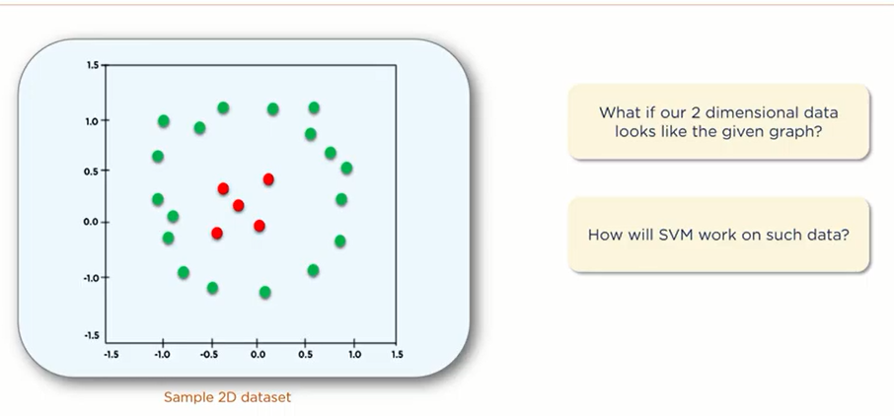
Non-linear SVM Example
The data set shown below has no clear linear separation between the two classes.
In machine learning parlance, you would say that these are not linearly separable.
How can you get the support vector machine to work on such data?
Since you can't separate it into two classes using a line, you need to transform it into a higher dimension by employing a kernel function to the data set.

Slide 25
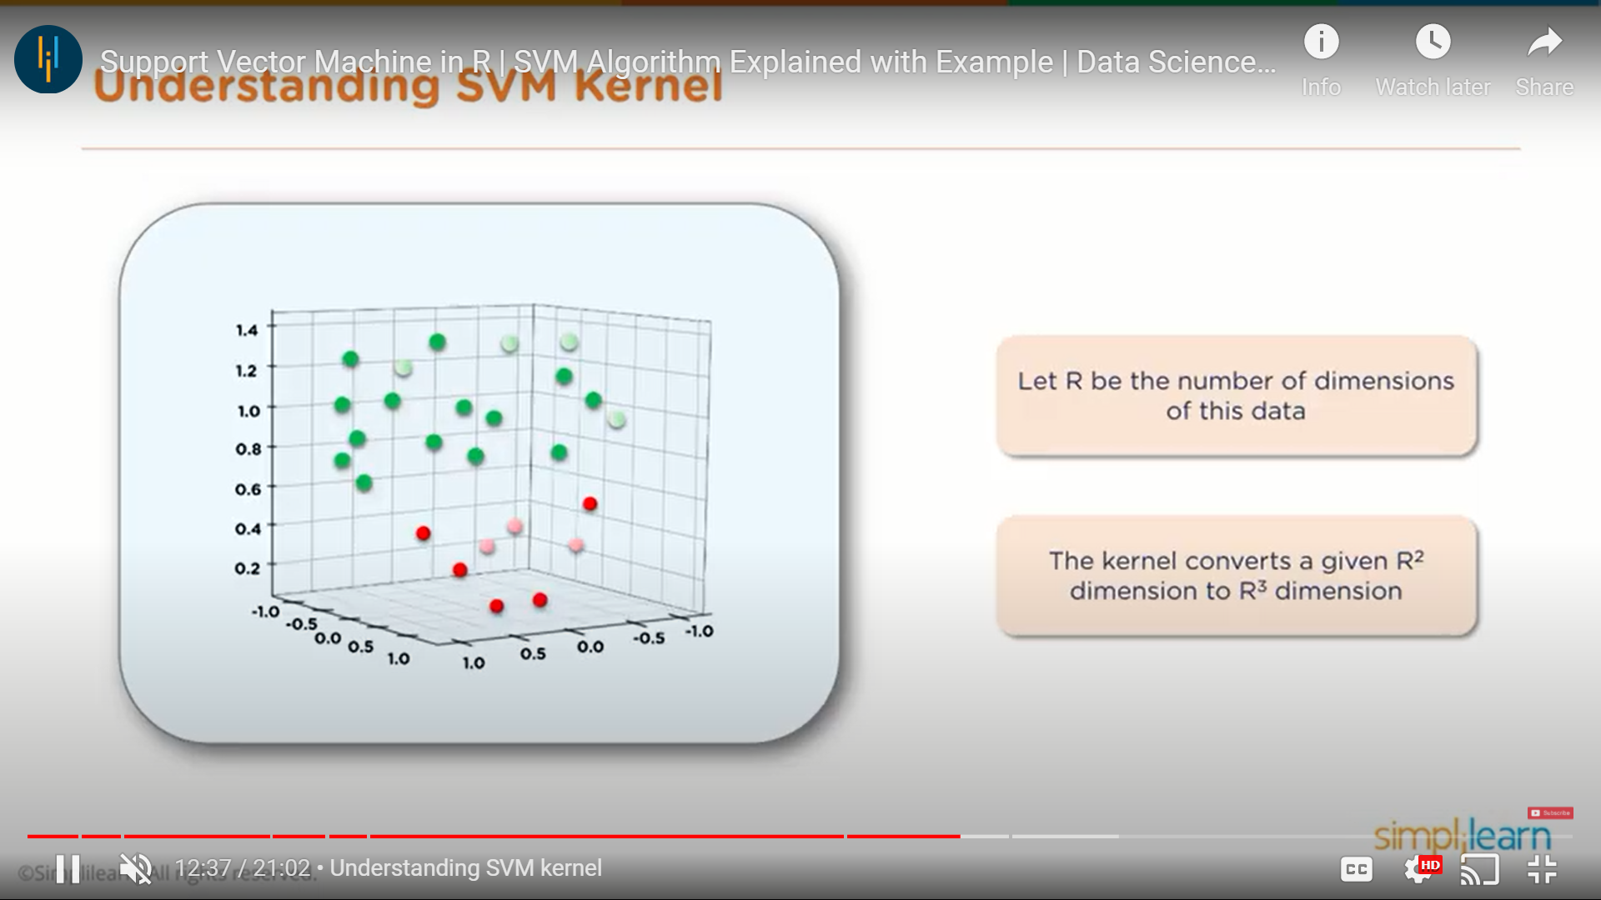
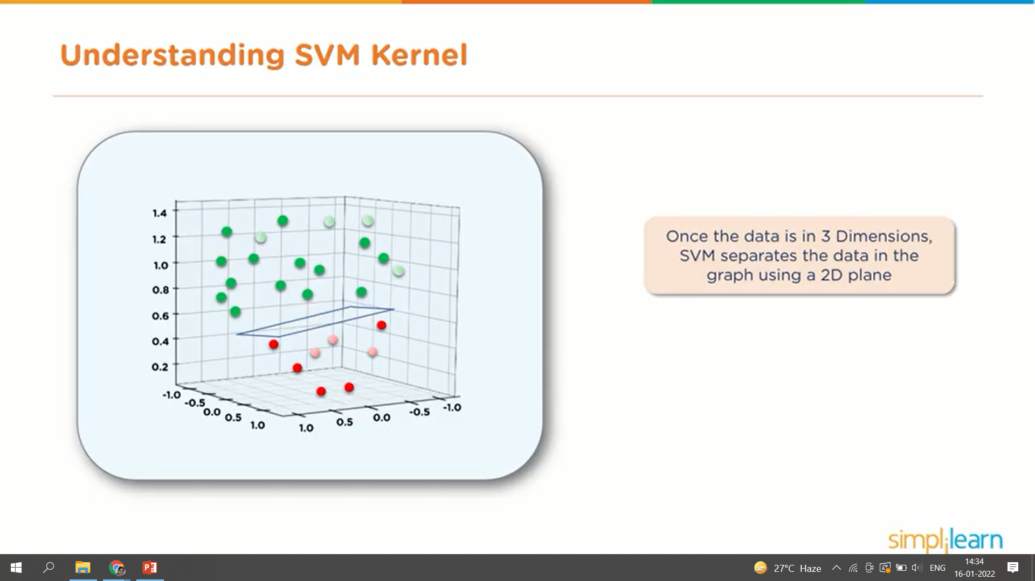

Slide 26
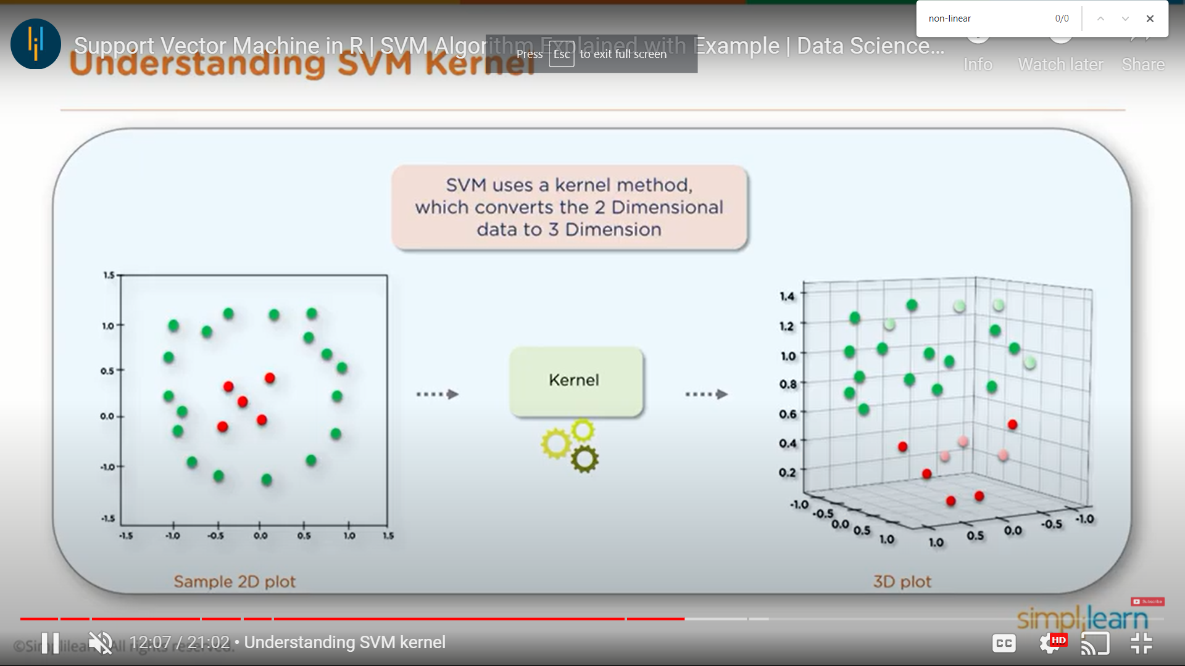
A higher dimension enables you to clearly separate the two groups with a plane.
Here, you can draw some planes between the green dots and the red dots — with the end goal of maximizing the margin.
If you let R=the number of dimensions, the kernel function will convert a two-dimensional space (R2) to a three-dimensional space (R3).
Once the data is separated into three dimensions, you can apply SVM and separate the two groups using a two-dimensional plane.

Slide 27
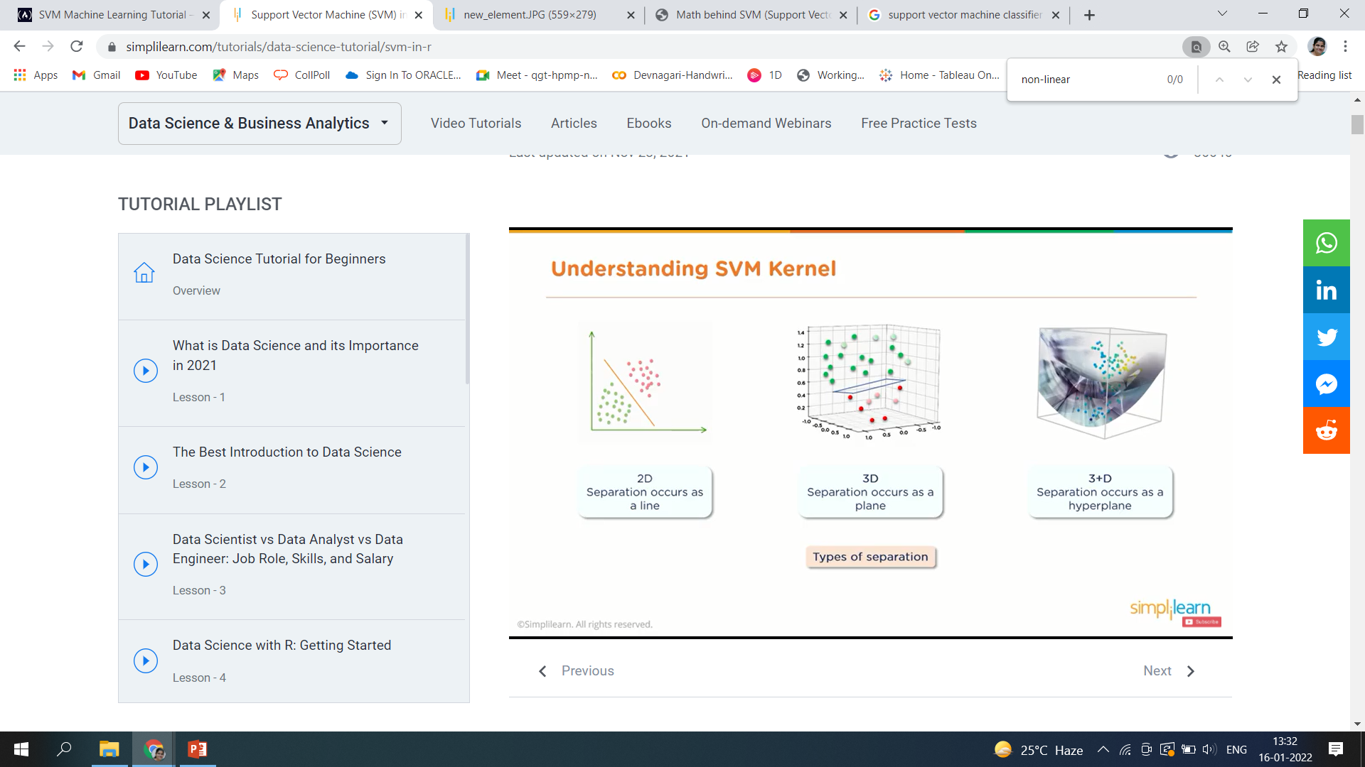
This is similar in the higher dimensions (3+D):

Slide 28
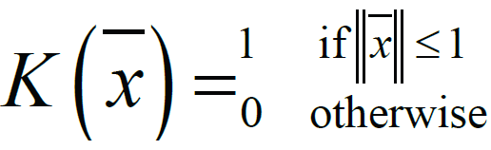
SVM Kernel Functions
SVM algorithms use a group of mathematical functions that are known as kernels. The function of a kernel is to require data as input and transform it into the desired form.
Different SVM algorithms use differing kinds of kernel functions. These functions are of different kinds—for instance, linear, nonlinear, polynomial, radial basis function (RBF), and sigmoid.
The most preferred kind of kernel function is RBF. Because it's localized and has a finite response along the complete x-axis.
The kernel functions return the scalar product between two points in an exceedingly suitable feature space. Thus by defining a notion of resemblance, with a little computing cost even in the case of very high-dimensional spaces.
The SVM uses what is called a “Kernel Trick” where the data is transformed and an optimal boundary is found for the possible outputs.

Slide 29
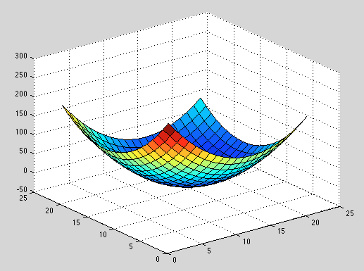
Mapping to Higher Dimensions
To solve this problem we shouldn’t just blindly add another dimension, we should transform the space so we generate this level difference intentionally.
Mapping from 2D to 3D
Let's assume that we add another dimension called X3. Another important transformation is that in the new dimension the points are organized using this formula x1² + x2².
If we plot the plane defined by the x² + y² formula, we will get something like this:

Slide 30
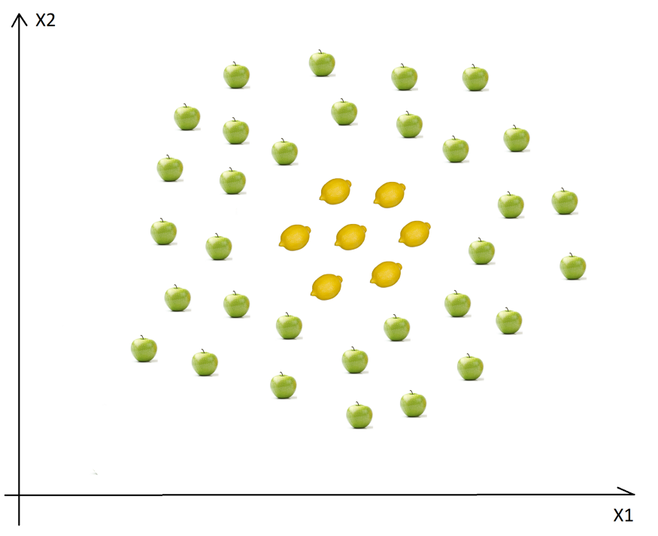
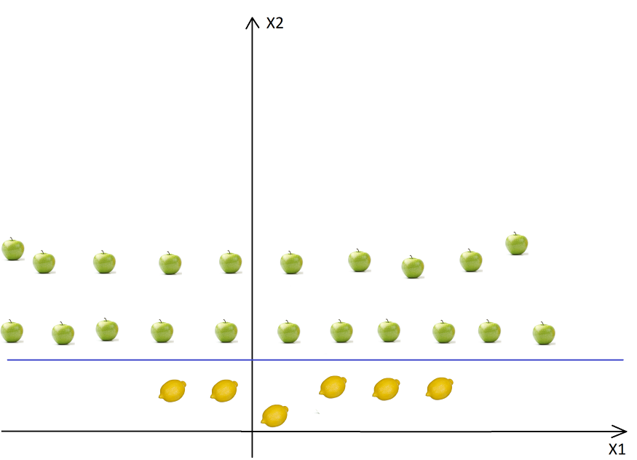
2D to 3D

Slide 31
Kernel functions
Linear
These are commonly recommended for text classification because most of these types of classification problems are linearly separable.
The linear kernel works really well when there are a lot of features, and text classification problems have a lot of features. Linear kernel functions are faster than most of the others and you have fewer parameters to optimize.
Here's the function that defines the linear kernel:
f(X) = w^T * X + b
In this equation, w is the weight vector that you want to minimize, X is the data that you're trying to classify, and b is the linear coefficient estimated from the training data. This equation defines the decision boundary that the SVM returns.
Polynomial
The polynomial kernel isn't used in practice very often because it isn't as computationally efficient as other kernels and its predictions aren't as accurate.
Here's the function for a polynomial kernel:
f(X1, X2) = (a + X1^T * X2) ^ b
This is one of the more simple polynomial kernel equations you can use. f(X1, X2) represents the polynomial decision boundary that will separate your data. X1 and X2 represent your data.

Slide 32
Gaussian Radial Basis Function (RBF)
One of the most powerful and commonly used kernels in SVMs. Usually the choice for non-linear data.
Here's the equation for an RBF kernel:
f(X1, X2) = exp(-gamma * ||X1 - X2||^2)
In this equation, gamma specifies how much a single training point has on the other data points around it. ||X1 - X2|| is the dot product between your features.
Sigmoid
More useful in neural networks than in support vector machines, but there are occasional specific use cases.
Here's the function for a sigmoid kernel:
f(X, y) = tanh(alpha * X^T * y + C)
In this function, alpha is a weight vector and C is an offset value to account for some mis-classification of data that can happen.

Slide 33
Here are some of the pros and cons for using SVMs.
Pros
Effective on datasets with multiple features, like financial or medical data.
Effective in cases where number of features is greater than the number of data points.
Uses a subset of training points in the decision function called support vectors which makes it memory efficient.
Different kernel functions can be specified for the decision function. You can use common kernels, but it's also possible to specify custom kernels.
Cons
If the number of features is a lot bigger than the number of data points, avoiding over-fitting when choosing kernel functions and regularization term is crucial.
SVMs don't directly provide probability estimates. Those are calculated using an expensive five-fold cross-validation.
Works best on small sample sets because of its high training time.

Slide 34
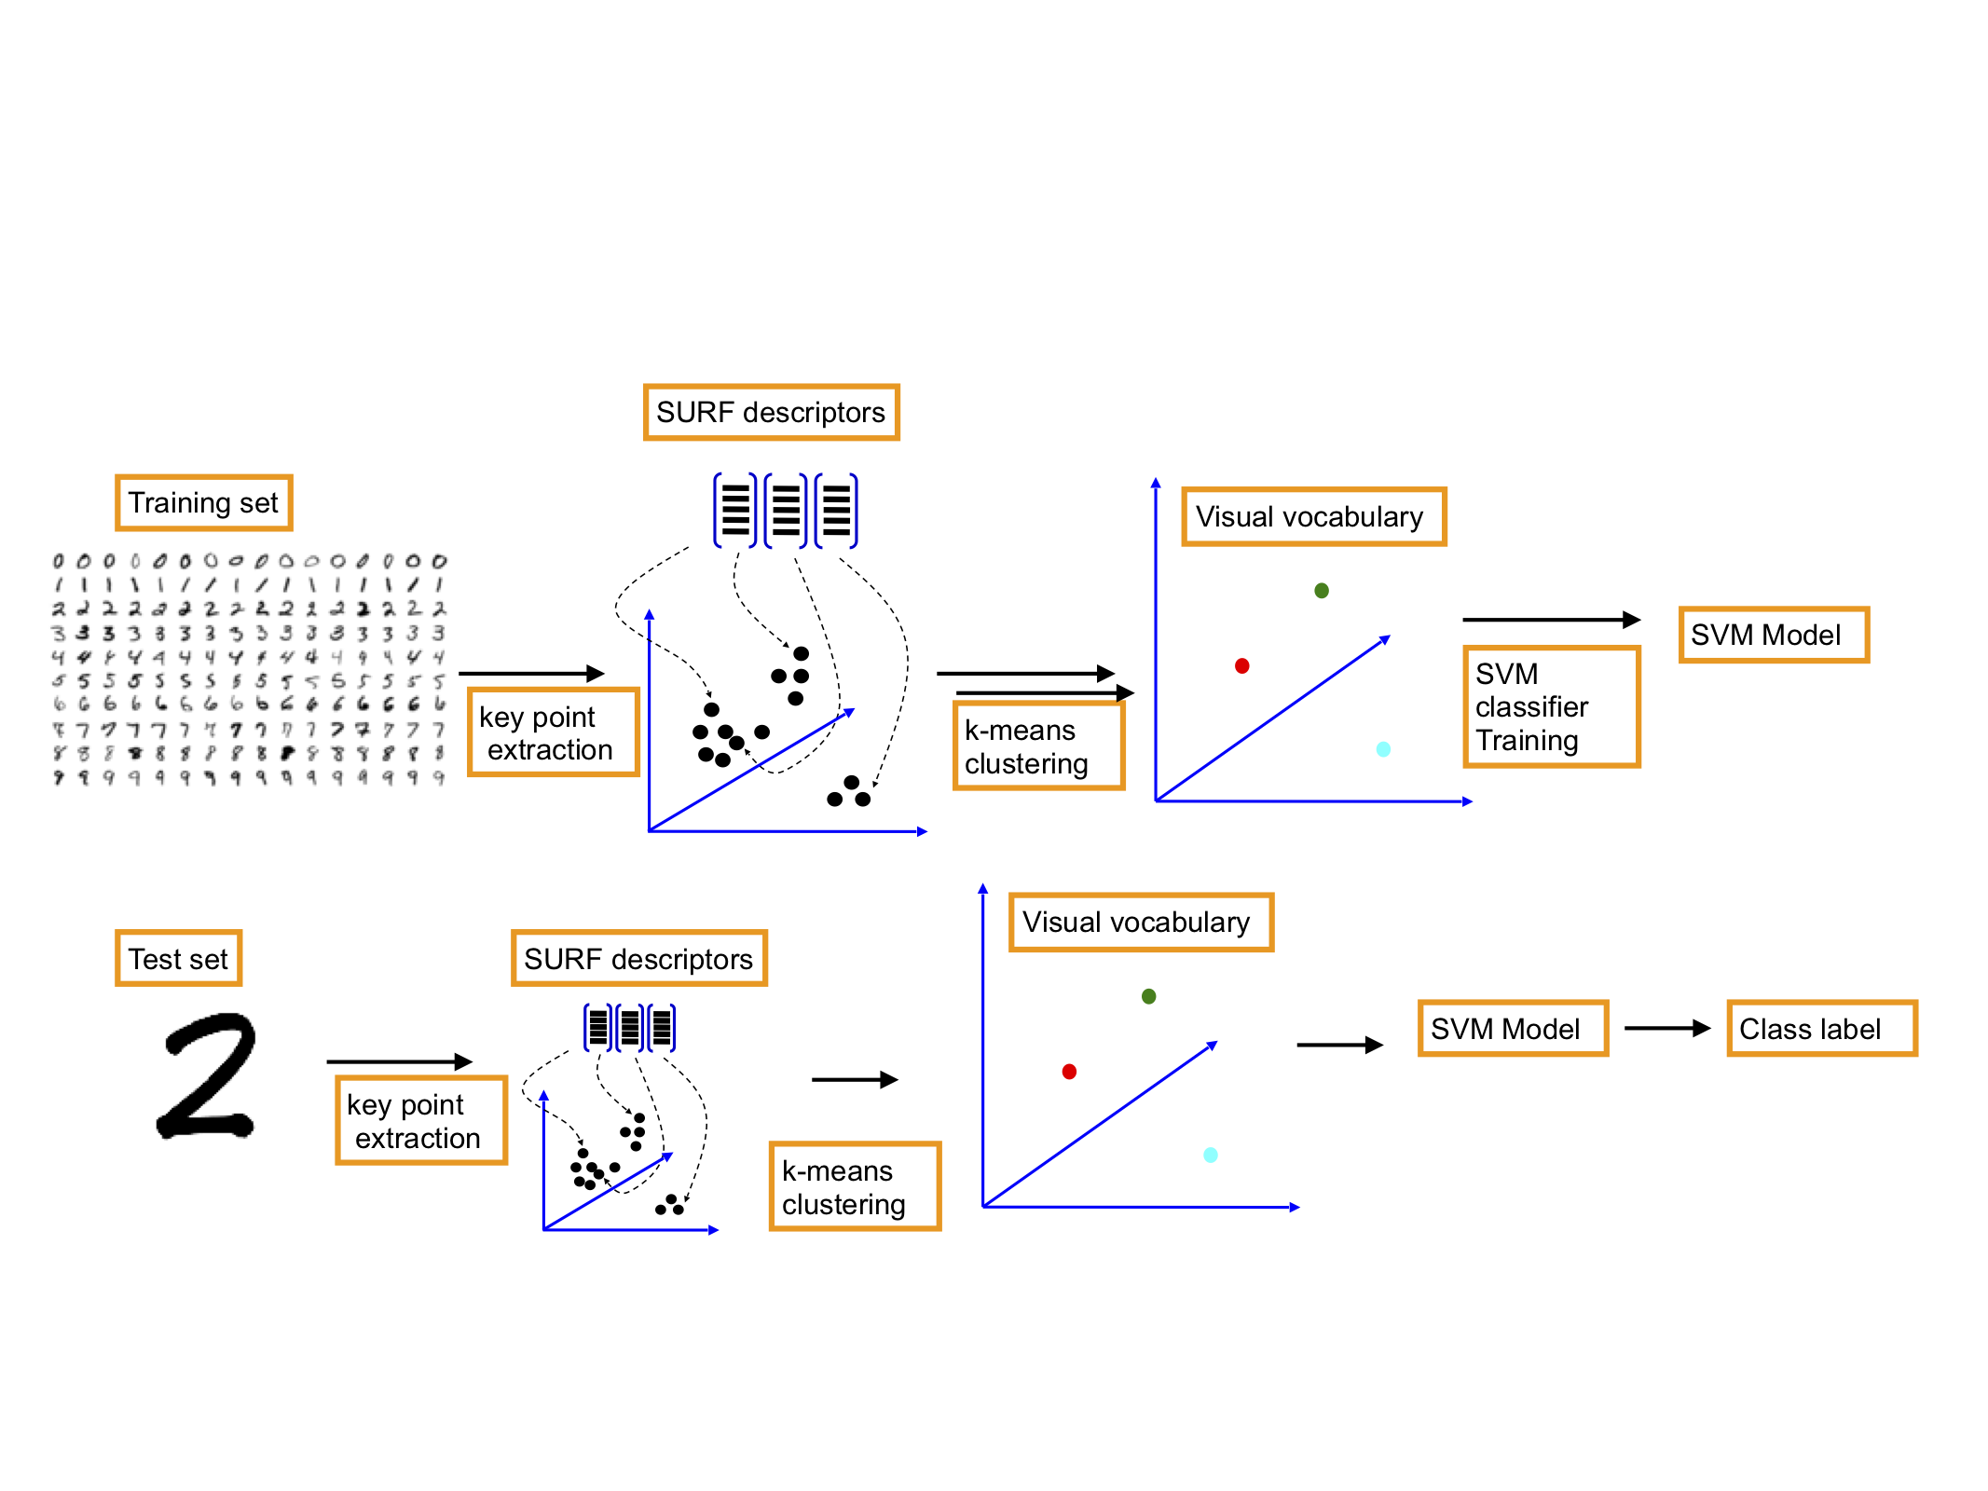
Digit Recognition using SVM

Slide 35
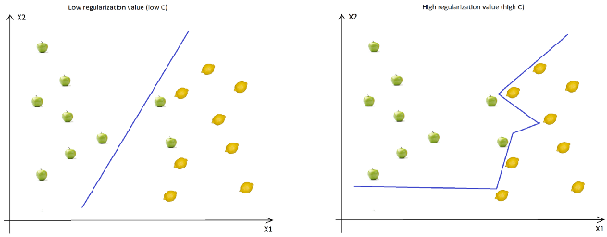
Regularization
The Regularization Parameter (in python it’s called C) tells the SVM optimization how much you want to avoid miss classifying each training example.
If the C is higher, the optimization will choose smaller margin hyperplane, so training data miss classification rate will be lower.
On the other hand, if the C is low, then the margin will be big, even if there will be miss classified training data examples. This is shown in the following two diagrams:
As you can see in the image, when the C is low, the margin is higher (so implicitly we don’t have so many curves, the line doesn’t strictly follows the data points) even if two apples were classified as lemons. When the C is high, the boundary is full of curves and all the training data was classified correctly. Don’t forget, even if all the training data was correctly classified, this doesn’t mean that increasing the C will always increase the precision (because of overfitting).

Slide 36
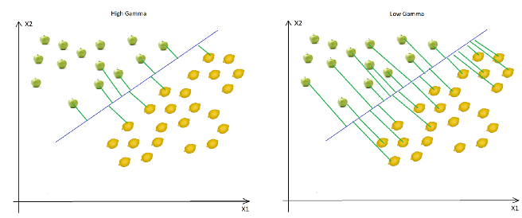
Gamma
The next important parameter is Gamma. The gamma parameter defines how far the influence of a single training example reaches. This means that high Gamma will consider only points close to the plausible hyperplane and low Gamma will consider points at greater distance.
As you can see, decreasing the Gamma will result that finding the correct hyperplane will consider points at greater distances so more and more points will be used (green lines indicates which points were considered when finding the optimal hyperplane).

Slide 37
SVM Function
#Fitting SVM to the Training set from sklearn.svm import SVC classifier = SVC(kernel = 'rbf', C = 0.1, gamma = 0.1) classifier.fit(X_train, y_train)
class sklearn.svm.SVC(*, C=1.0, kernel='rbf', degree=3, gamma='scale', coef0=0.0, shrinking=True, probability=False, tol=0.001, cache_size=200, class_weight=None, verbose=False, max_iter=- 1, decision_function_shape='ovr', break_ties=False, random_state=None)
Rference-https://scikit-learn.org/stable/modules/generated/sklearn.svm.SVC.html

Slide 38
Svc comparison Accuracy and MSE overfitting and underfitting (train and test) tarin 60 test 50
Kernel | C=1.0 | 100 | 1000 | degree
linear |  |  |  | NA
rbf |  |  |  | NA
Polynomial |  |  |  | 4,5,….
sigmoid

